Slide 1

Serializable isolation level in sql

Slide 2
What Is It ???
It is the highest level of transaction isolation, providing the strictest guarantees for data consistency and integrity. When transactions operate under serializable isolation, they execute as if they were processed one after another, without any interference or concurrency effects from other transactions occurring concurrently.

Slide 3
Significance
Ensuring Data Integrity
Maintaining Consistency
Application Assurance
Consistency in Complex Transactions

Slide 4
example
Transactions Of The Account:
BEGIN TRANSACTION ISOLATION LEVEL SERIALIZABLE;
UPDATE accounts SET balance = balance - 50 WHERE account_id = 100;
UPDATE accounts SET balance = balance + 50 WHERE account_id = 200;
COMMIT;
Output:
Account 1 : 50
Account 2 : 250

Slide 5
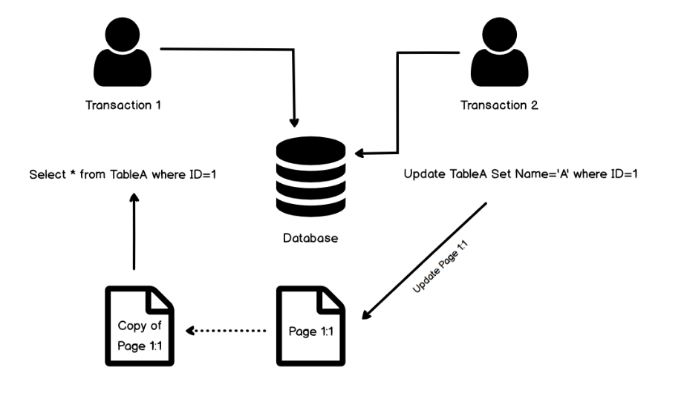

Slide 6
conclusion
It offers the highest level of isolation among different transactions .However, this level of isolation comes with A cost in terms of performance due to increased concurrency control mechanisms, such as locking. Therefore, while serializable isolation guarantees the integrity of data, it's essential to weigh its benefits against the potential impact on system performance and scalability, and consider it judiciously based on the specific requirements and characteristics of the application.

Slide 7


